Slide 1
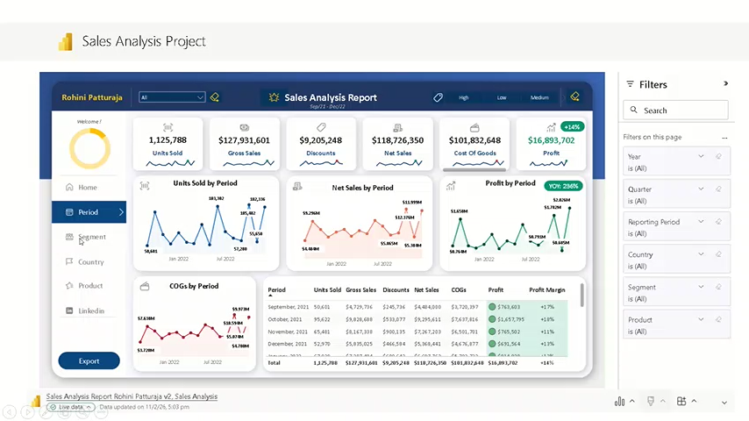


Sales Analysis Project

